Slide 1
Predictive Analytics / Machine Learning
Discovery, Exploration and Prediction

Slide 2
About me
Albert Opoku
Senior Statistical Consultant at Alliance data Inc
Masters in Financial Economics from Ohio University
Bachelors in Economics from Kwame Nkrumah University of Science and Technology
Contact me:
Twitter @opalbert
LinkedIn Albert Opoku
Email opalkabert@gmail.com
Website www.opokualbert.com

Slide 3
Agenda
Overview of Predictive Analytics/ Machine learning.
Business Need and Data Discovery.
Data Exploration.
Model building Process.
Model Serving or Production.

Slide 4
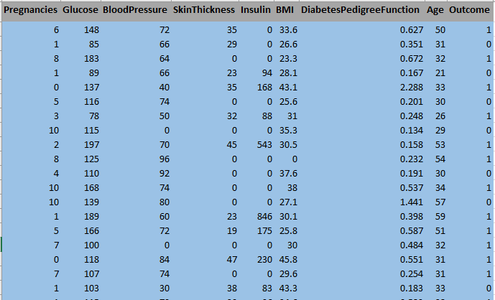
Predictive Analytics/Machine learning - Insight
Predictive analytics attempts to predict something you do not know from facts you do know.
Characteristics of a house to predict the value
Whether a patient will develop diabetes or not
Monthly minutes a cell phone customer would consume
Whether a borrower would make monthly payment or default

Slide 5
Business Value
Predictive analytics drives business value because reliable prediction leads to better decision.
If you can predict the value of a house you can set the asking price with confidence.
Predicting disease, cell phone usage, payment behavior helps in making treatment decisions, price cell phone products, decide to approve a loan or not.

Slide 6
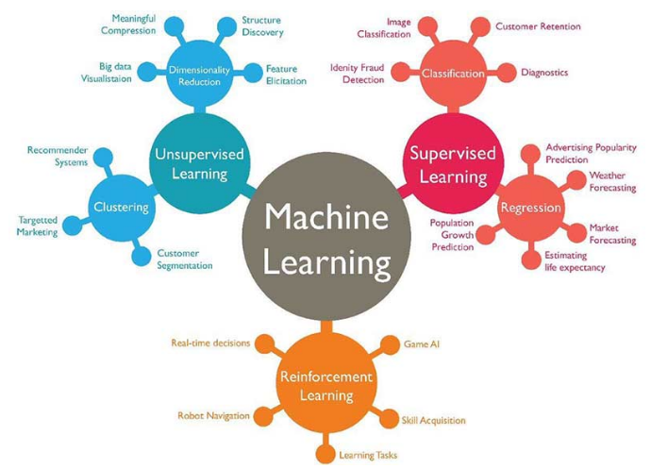
Types of Machine Learning and Business Use Cases

Slide 7
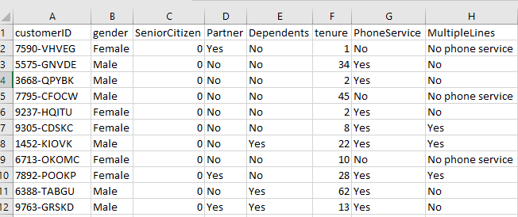
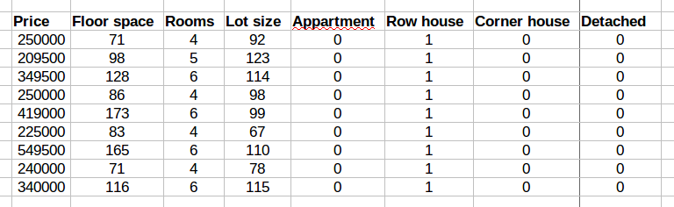
Types of Machine Learning and Business Use Cases
You help the algorithm to learn
You do not know what is hidden in the data. Let algorithm learn on its own and tell you what is there
Supervised Learning - House Value Data
Unsupervised Learning – Telco Customers
Output
Inputs

Slide 8
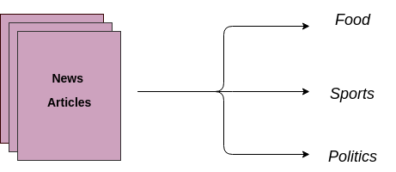
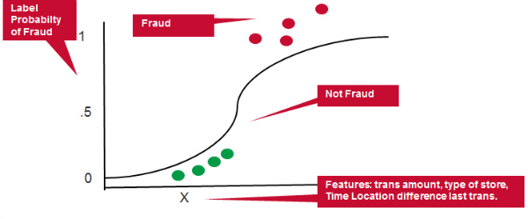
Classification and Clustering Example
3 Components
Data:
Strongly depends on the historical data quality
Modeling:
Simple and complex modeling techniques are used to get insights and inference from data
Expectation:
The future will follow a pattern related to the past.

Slide 9
Define business needs
Understand the business problem
Improve marketing campaign response rate by at least 10%
Reduce loan losses by 15%
Increase customer retention by 8%
Define response measure - sometimes multiple measures.
Example a university wants to maximize ROI in an alumni donor campaign. Strategies:
The likelihood to respond to the campaign
The amount that will be donated if responded.
Cost of Error
Does the prediction development cost outweigh its improvement in decision making?
If the value at risk is low, model provides no economic benefit. Example email campaign
Determine the prediction window
Lengthy prediction window leads to model precision decline
The window also determine the data you will use

Slide 10
Discover data for the project
Assess the deployment environment
Batch
Transactional or near real time
This task takes a lot of your time.
Assemble Data
Relevant data may live in diverse sources inside and outside the organization
Investigating potential sources, understand how the data was captured
Most times data is messy and needs cleaning
Involves collecting and consolidating data
Secure data documentation and permission to use the data
Evaluate the Data
Determine the presence or absence of a key if there will be a join of two or more tables
Make sure the fields are populated. Fields with no value throughout can be dropped.
Check for variance in the fields. Drop fields with same value

Slide 11
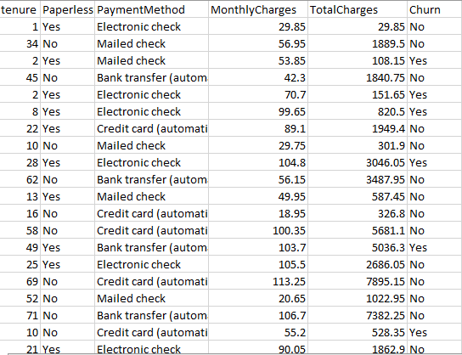
Evaluate the Data
Determine the type of data in the fields. E.g float, int, character/string, date etc
Does the data have the response measure?
Float
Int
Response

Slide 12
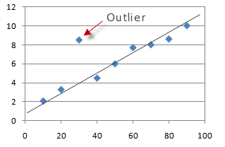
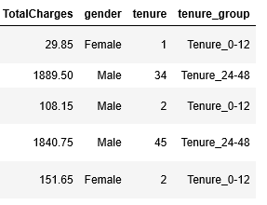
Data Exploratory and Feature Engineering
Evaluate the Data
Look for and investigate outliers.
In some cases you don’t have to remove them
Transform the Data
Here are the reasons the data may be transformed:
The data from the source not conforming to the business rules
Improve model accuracy and precision
Possible transformation include:
Log transform or Z score scaling
Binning numeric features like age
Encoding of categorical variables
e.g one-hot-encoding or embeddings
Binning or Bucketing

Slide 13
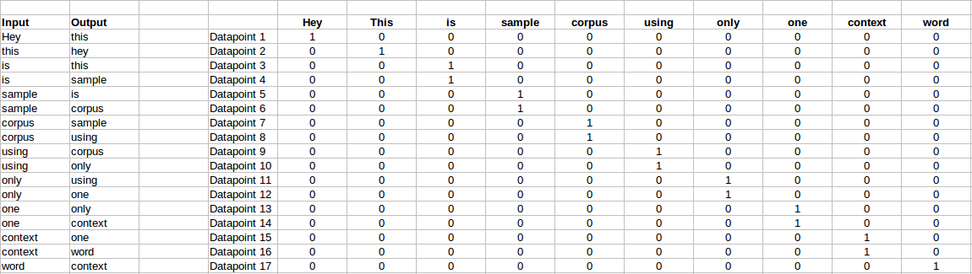
one-hot-encoding

Slide 14
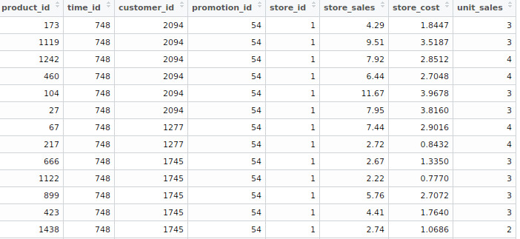
Data Exploration and Feature Engineering
Perform Table Operation
Join and append tables
Select/drop rows
Add calculated field
Drop columns that are not relevant for the project
Group by a key if there is the need
Treat Missing Data
Sometimes, the missing chunk is a signal itself
so you can binarize the column.
The following techniques can be used to treat missing values:
Impute with a simple mean
K nearest neighbor could be used
Regression techniques are also acceptable
REMEMBER TO APPLY THESE TRANSFORMATIONS TO THE DEPLOYMENT ENVIRONMENT

Slide 15
Model building Process
Popular Model Techniques
Feature Selection
You may have multiple features and you will have to reduce them to a sizable and easy to explain number and also avoid a curse of dimensionality. The following techniques may be used:
Information Value using Weight of evidence
Variable Importance using Random Forest
Recursive Feature Elimination
Variable Importance using Extra trees classifier
Insurance fraud
Customer attrition
Campaign response
Logistics Regression
Decision Trees
Random Forest
Support Vector Machines
Classification problem
House value
Customer spend
Temperature
Linear Regression
Regression Problem
Segmentation
Association
Text mining
K-Means Clustering
Hierarchical Clustering
Apriori
Language Models
Clustering problem

Slide 16
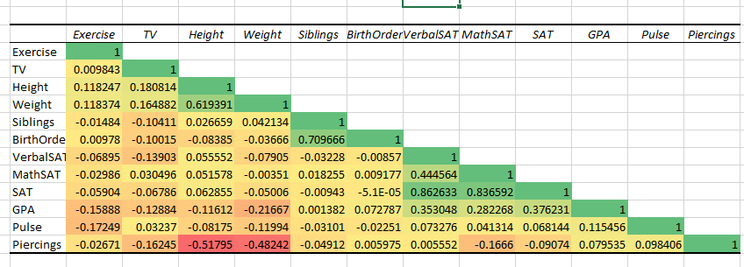
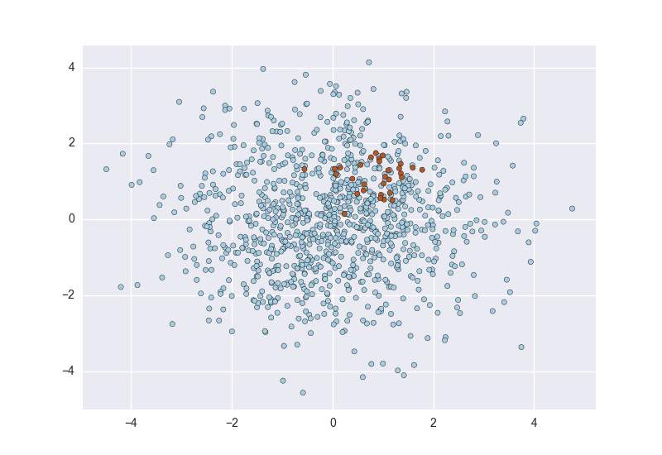
Extra trees classifier
Chi Square best variables
L1 based feature selection
You can use the vote based approach
Check for Multicollinearity
When two or more feature are linearly correlated
Sampling
Your data must be a representative of the population you are predicting for
To avoid biases in your outcome,
your sample should have a balance representation
Down-sample or up-sample if your lable is unbalanced
If your dataset is large, sample a sizeable part for your
Training.

Slide 17
Partition the Dataset
Training set
Intime Validation set
Out of time Validation set
Execute your model and evaluate the results
Base on your data and model goal, use the appropriate technique to build your model
You may explore multiple algorithms
In classification model, accuracy and ROC are not enough, complement with confusion matrix
For regression problems, use Root Mean Squared Error – RMSE for your evaluation

